Slide 1
BENIGN TUMORS OF CONNECTIVE TISSUE ORIGIN
Presentation by
Anisha Rajan
( intern )

Slide 2
PYOGENIC GRANULOMA
Also called ‘Granuloma Pyogenicum’
Originate as a response of tissues to non specific infection
Tumor –like growth ,considered as an exaggerated ,conditioned response to minor trauma

Slide 3
Aetiology -
Originally believed to be a botryomycotic infection
Also was thought to be caused by pyogenic infection by Staphylococci and Streptococci
Now Pyogenic Granuloma is thought to represent an exuberant tissue response to local irritation or trauma

Slide 4
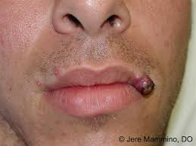
Clinical Features -
It arises as a elevated, pedunculated or sessile vascular mass with a smooth, lobulated or even a warty surface
Most common site – Gingiva (75%)
Females > Males
Lesions more common on facial aspect of gingiva
Other sites – lips, tongue, buccal mucosa
Most common area of occurrence – Maxillary Anterior region
Surface is commonly ulcerated – therefore can show a tendency for haemorrhage either spontaneously or on slight trauma

Slide 5
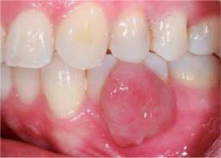
Can be single or multiple
Can be unilateral or bilateral
Colour ranges from pink to red to purple, depending on the age of the lesion
Young lesions – highly vascular in appearance
Older lesions – more collagenized and pink
Size – vary from few millimetres to diameter
When it develops in gingiva of pregnant women – pregnancy tumour or granuloma gravidum

Slide 6
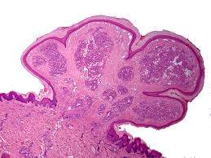
Histopathology -
Shows a highly vascular proliferation that resemble granulation tissue
Overlying epithelium is thin ,atrophic or may be hyperplastic
If ulcerated – shows a fibrous exudate of varying thickness over the surface
Most startling feature – occurence of vast number of endothelium – lined vascular spaces and extreme proliferation of fibroblasts and budding endothelial cells

Slide 7
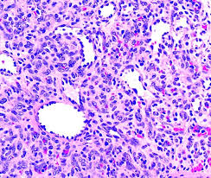
Usually consists of moderately intense infiltration of Polymorphonuclear leukocytes , lymphocytes , plasma cells
Older lesions have more fibrous apperance
Pregnancy tumour histologically resemble Pyogenic granuloma

Slide 8
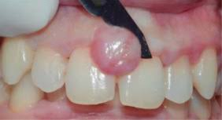
Treatment and prognosis -
Consists of conservative surgical excision ( usually curative)
For gingival lesions – excision should extend down to periosteum and adjacent teeth should be scaled to remove source of irritation
In case of pregnancy tumor – generally no treatment is done unless significant functional or aesthetic problems develop
Occasionally can recur – 3 % to 15 % (as not encapsulated)

Slide 9
PERIPHERAL OSSIFYING FIBROMA
Also called ( Peripheral Odontogenic Fibroma , Peripheral Cementifying Fibroma , Calcifying or Ossifying Fibroid Epulis )
Peripheral ossifying fibroma denotes relatively common gingival lesion characterised by high degree of cellularity usually representing bone formation
Common gingival growth – considered to be reactive rather than neoplastic

Slide 10
Aetiology -
Some investigators believe that origin is odontogenic and is derived from periodontal ligament (especially because it occurs on gingiva and may contain oxytalin fibres)
At present its exact derivation is still uncertain

Slide 11
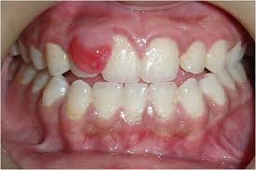
Clinical Features -
Age – children and teenagers > adults
Gender – females > males
Area – maxilla = mandible
Common in anterior region
Site – exclusively on gingiva
Colour – red to pink

Slide 12
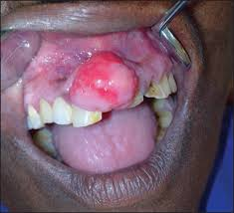
Appear as a nodular mass , either pedunculated or sessile, that usually emanates from interdental papilla
Surface may be ulcerated or intact
Most lesions are less than 2 cm in size
Red ulcerated lesions may be mistaken as pyogenic granuloma

Slide 13
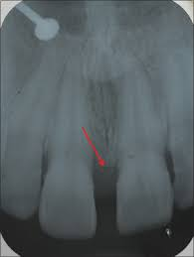
Radiographic appearance -
In vast majority of cases – no apparent underlying bone involvement
Rarely – superficial erosion of bone

Slide 14
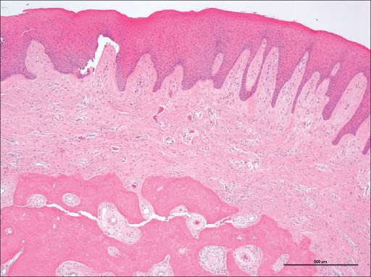
Histology -
Basic microscopic feature is one of a fibrous proliferation associated with formation of mineralised tissue
Surface – either intact or more frequently , an ulcerated layer of stratified squamous epithelium
Bulk of lesion – consists of exceedingly cellular mass of connective tissue comprising of large number of plump proliferating fibroblasts intermingled throughout a very delicate fibrillar stroma

Slide 15
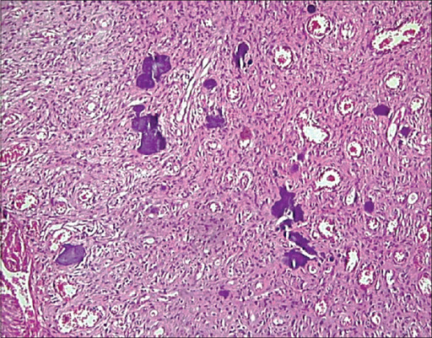
`
Exhibit high degree of cellularity
Vascularity is not so pronounced as in pyogenic granuloma
Several forms of calcifications can occur , consisting of bone , cementum like material , or dystrophic calcifications
Usually bone is woven and trabecular in type , although older lesion demonstrate mature lamellar bone
Occasionally multinucleated giant cells may be seen

Slide 16
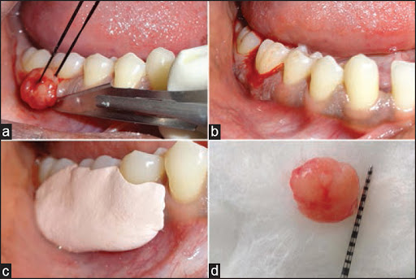
Treatment and prognosis -
Treatment of choice is local surgical excision , followed by thorough scaling of adjacent teeth to remove irritants
A reccurence rate of 8% to 16% is noticed

Slide 17
EPULIS FISSURATUM
Also called ( Inflammatory Fibrous Hyperplasia, Denture Injury Tumour , Denture Epulis )
Epulis is a term which denotes any tumor of gingiva or alveolar mucosa
It is a tumor like hyperplasia of fibrous connective tissue that develops in association with the flange of an ill fitting complete or partial denture

Slide 18
Aetiology -
The cause of Epulis Fissuratum is chronic low grade irritation from an ill- fitting denture
Frequently , this is the consequence of resorption of alveolar ridge so that the denture moves further into vestibular mucosa , creating an inflammatory fibrous hyperplasia that proliferates over the flange

Slide 19
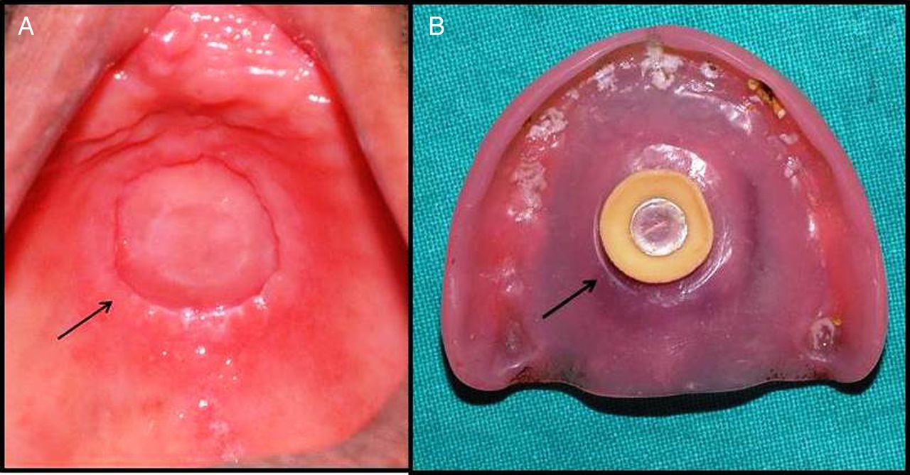
Clinical Features -
Epulis Fissuratum typically appears as a single or multiple folds of hyperplastic tissue in alveolar vestibule
Most often , there are two folds of tissue , and the flange of the associated denture fits conveniently into the fissure between the folds
The redunctant tissue is usually firm and fibrous
Usually demonstrate surface areas of inflammatory papillary hyperplasia

Slide 20
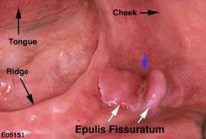
Size can vary from less than 1cm to involve most of the length of vestibule
Most common site of occurrence – facial aspect of alveolar ridge. ( Occasionally seen on lingual aspect of mandibular alveolar ridge )
Age group = middle aged and older adults
Anterior portion of jaw > posterior part
Females > Males
Can occur in either maxilla or mandible

Slide 21
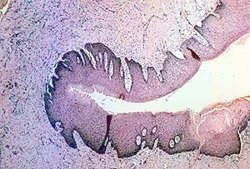
Histological features -
Reveals hyperplasia of fibrous connective tissue
Overlying epithelium is frequently hyperparakeratotic and demonstrate irregular hyperplasia of rete ridges
Focal areas of ulceration is common at the base of the grooves between the folds

Slide 22
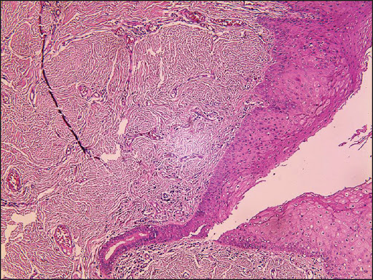
In some cases the epithelium shows inflammatory hyperplasia
In rare instances , the formation of osteoid or chondroid is observed

Slide 23
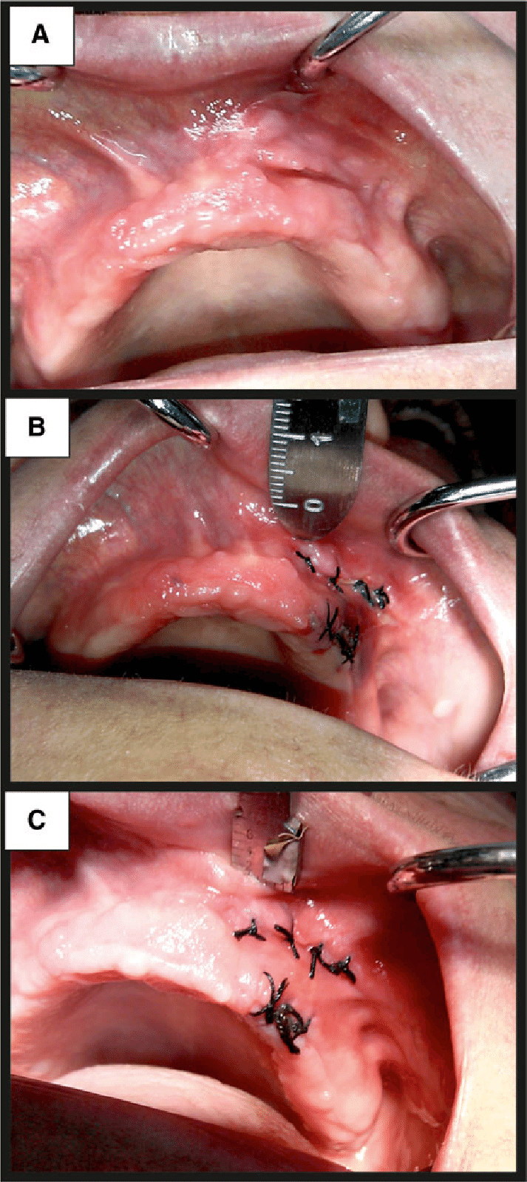
Treatment and prognosis -
Surgical excision of hyperplastic tissue
The ill – fitting denture should be remade or relined to prevent the recurrence of the lesion

Slide 24
INFLAMMATORY PAPILLARY HYPERPLASIA
Also called Denture Papillomatosis
It is a reactive tissue growth that usually , although not always , develops beneath a denture
Generally involves mucosa of palate

Slide 25
Aetiology -
Exact cause is unknown
Condition is often related to following –
An ill – fitting denture
Poor denture hygiene
Wearing the denture 24 hours a day

Slide 26
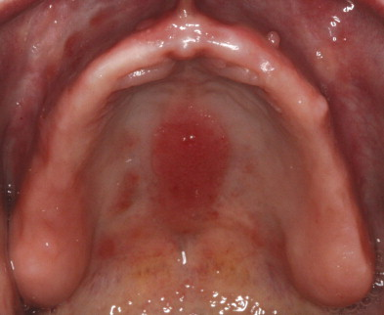
Clinical Features -
Papillary hyperplasia occur predominantly in edentulous patients with dentures
Usual site of occurrence – hard palate beneath the denture base
Can occur at any age in the adult
No definite sex predilection
Usually asymptomatic

Slide 27
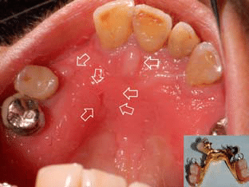
Early lesions may only involve the palatal vault
Advanced cases can cover most of the palate
The lesions present itself as numerous , closely arranged , oedematous papillary projections ,often involving nearly all of the hard palate , and imparting a warty appearance

Slide 28
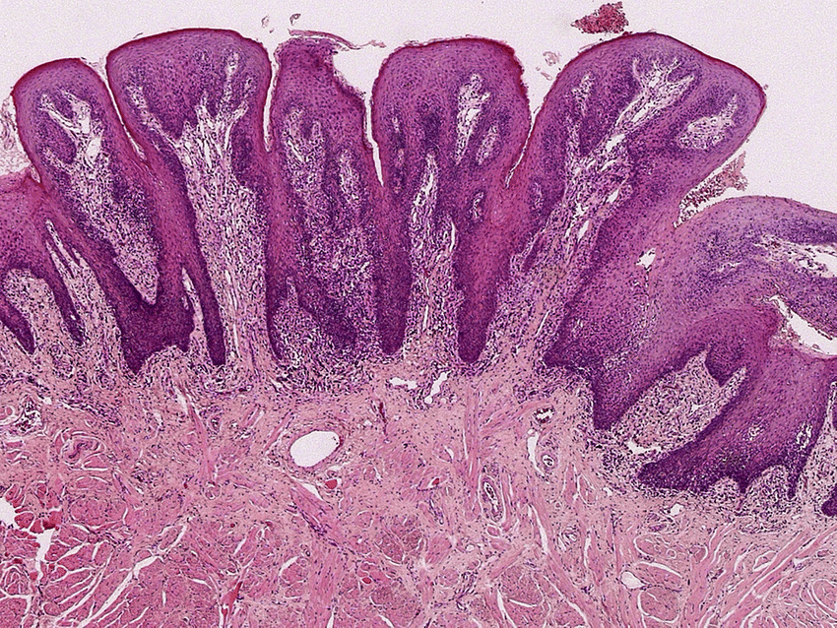
Histological Features -
Show numerous , papillary growths on the surface that are covered by hyperplastic stratified squamous epithelium
Epithelium can be orthokeratinised or parakeratinised
Consists of central core of connective tissue

Slide 29
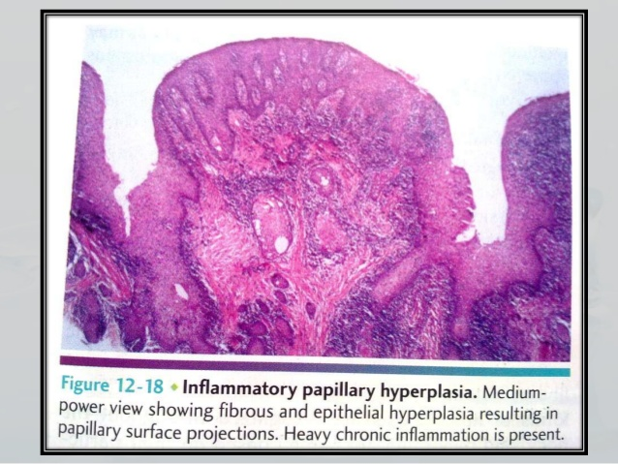
Pseudoepitheliomatous hyperplasia , in varying degrees , is seen in vast majority of cases
Connective tissue can vary from loose and oedematous to densely collagenized
A chronic inflammatory cell infiltrate is usually seen ,consisting of lymphocytes and plasma cells
Less frequently PMNS can be seen

Slide 30
Treatment and Prognosis -
For very early lesions – removal of denture can allow erythema and oedema to subside
The condition may show improvement with topical or systemic antifungal therapy
For advanced lesions – excision of hyperplastic tissue before fabricating a new denture
Various surgical methods -
Partial - thickness or full – thickness surgical blade excision
Curettage
Electro surgery
Cryosurgery
Laser surgery

Slide 31
VERRUCIFORM XANTHOMA
Also called Verrucous Xanthoma , Inflammatory Papillary Hyperplasia with Foam cell Response
Verruciform xanthoma is a hyperplasic condition of the epithelium , with a characteristic subepithelial accumulation of lipid laden histiocytes
It is primarily an oral disease , but skin and genital lesions are also possible
The lesion usually represents an unusual reaction or immune response to localized epithelial injury or trauma

Slide 32
Aetiology -
The etiopathogenesis of verruciform xanthoma is unknown
It is thought that damage to squamous cells with increased epithelial cell turnover , leading to deposition of epithelial cell debris that is engulfed by macrophages in the corium may lead to development of this lesion
An immunologic aetiology has also been proposed

Slide 33
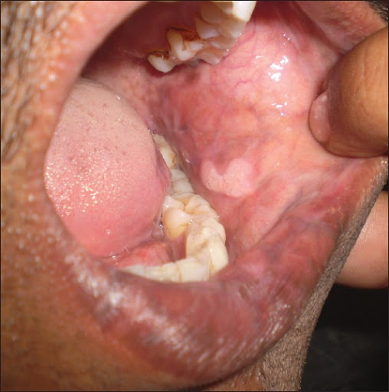
Clinical Features -
An uncommon disease
Age – vary from 2 to 89 years
Mean age group – 40 – 50 years
No gender predilection
Common site – masticatory mucosa of alveolar ridge , gingiva , palate ( 75 %)
Other sites – buccal mucosa , floor of mouth , tongue
Typically seen in whites
Size – mostly less than 2cm in diameter

Slide 34
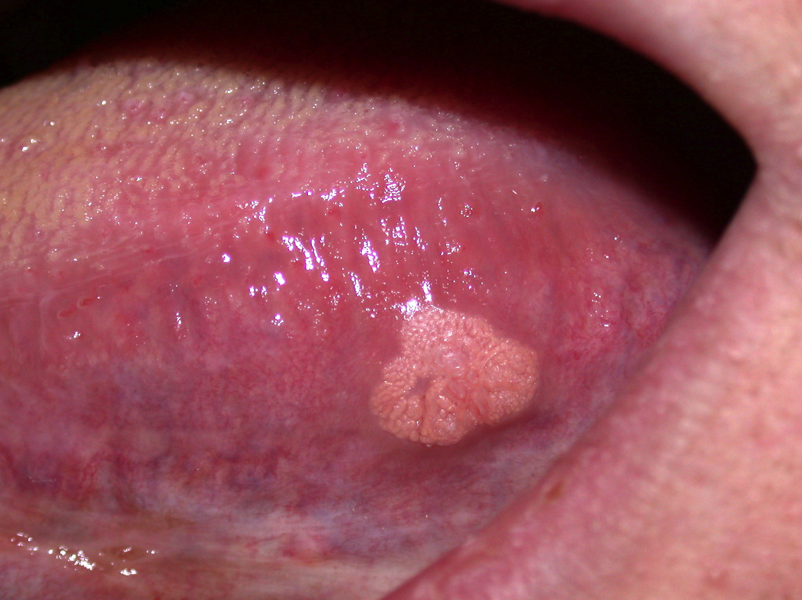
The lesion appears as well – demarcated , soft , painless , sessile or pedunculated , slightly elevated mass
Appear white , yellow – white or red in colour
Surface appears papillary or roughened , rarely flat – topped nodules seen without surface projections
Clinically resemble squamous papilloma, condylomata acuminatum, or early carcinoma

Slide 35
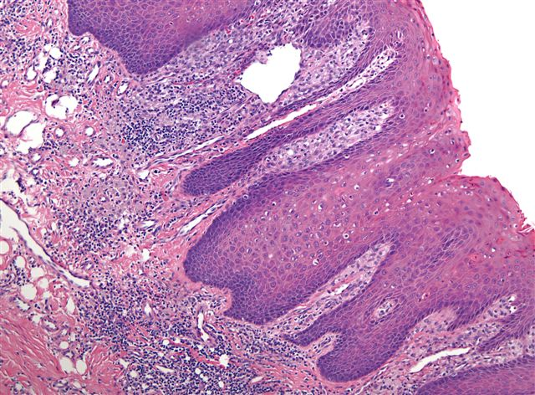
Histological Features -
Demonstrates papillary , acanthotic surface epithelium covered by a thickened layer of parakeratin
Most striking and characteristic feature of connective tissue papillae between the epithelial pegs is the presence of large foam cells known as xanthoma cells
The pushing effect of the papillary macrophages is responsible for elongated reteridges

Slide 36
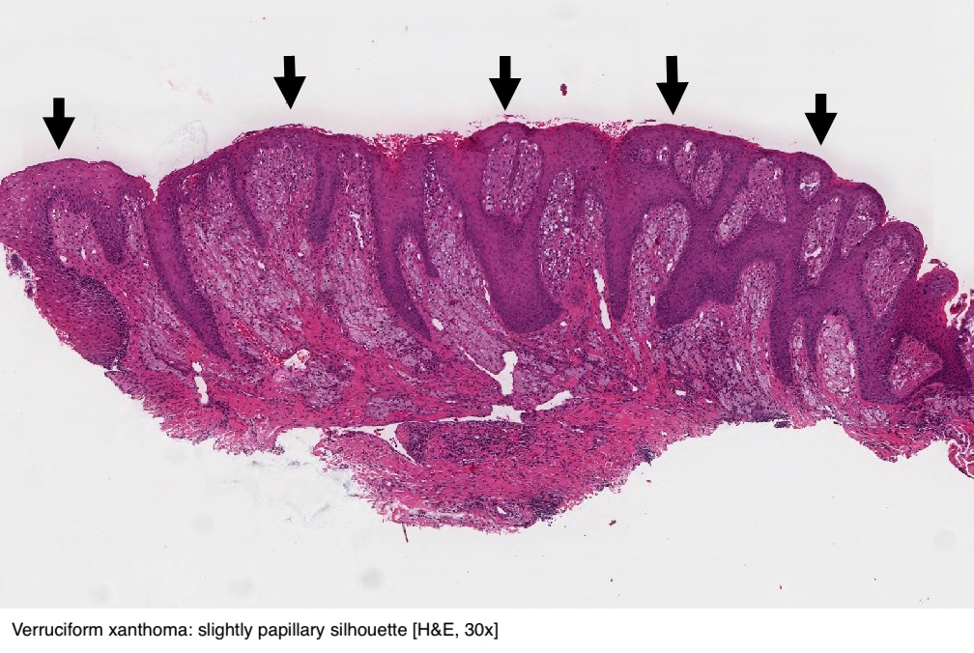
A slight inflammatory infiltrate may be present beneath the lesion
Occasional lesions have been associated with a massive lichenoid infiltrate
No granulomatous changes ,other than foamy macrophages is seen

Slide 37
Treatment and Prognosis -
Treated with conservative surgical excision
Recurrence is rare

Slide 38
LIPOMA
Relatively rare intraoral tumor
Benign tumour of fat, a slow growing neoplasm
Lipomas of oral and maxillofacial regions account for only 1% to 4 %

Slide 39
Aetiology -
The pathogenesis of lipomas is uncertain
They appear to be common in obese people
However the metabolism of lipomas is completely independent of normal body fat , if the calorie intake is reduced , lipomas do not decrease in size, although normal body fat may be lost

Slide 40
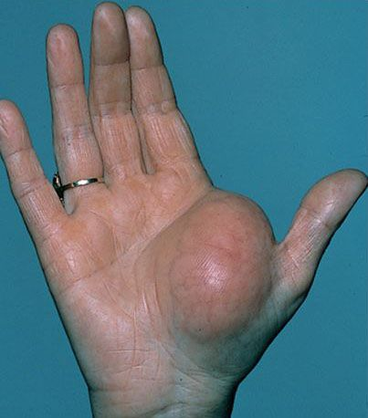
Clinical Features -
Common age group – 30 yrs and above
No gender predilection
Common in head and neck regions (13 %) of the lipomas
Intraoral occurrence is rare
Intraoral site include – tongue , floor of mouth , buccal mucosa , gingiva , mucobuccal or labial folds

Slide 41
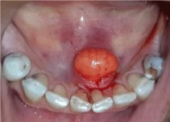
Intraoral lipomas – types include
Superficial form
Diffuse form
Encapsulated form
Superficial form – appear as a single or lobulated , painless lesion attached by either a sessile or a pedunculated base . Epithelium is usually thin, with a yellow surface discoloration and readily visible blood vessels
Diffuse form – affect deeper tissues , when palpated it feels like fluid ( sometimes mistaken for cyst)
Diagnosis is essentially a clinical one

Slide 42
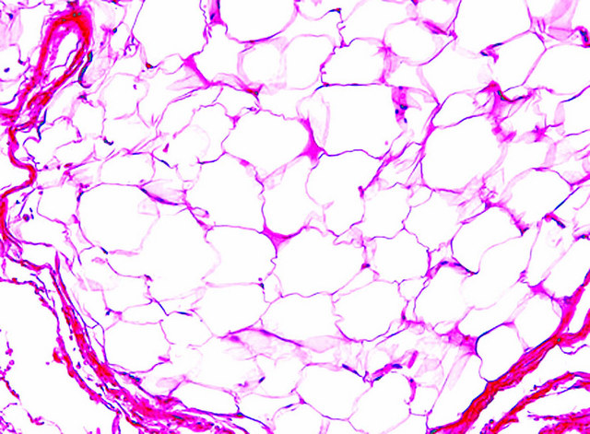
Histological Features -
Composed predominantly of mature adipocytes, possibly admixed with collagenic streaks, and often well demarcate from surrounding connective tissues
A thin fibrous capsule may be seen
Infiltrating lipoma – when lesional fat cells are seen to infiltrate into surrounding tissues , producing a thin extentions of fatty tissue radiating from central tumour mass

Slide 43
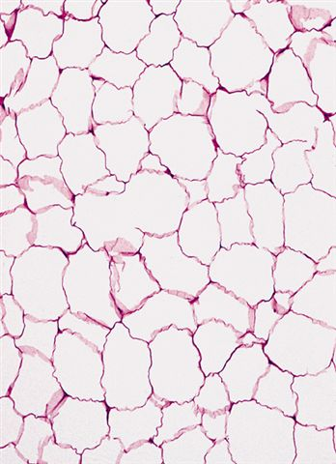
Fibrolipoma – excessive fibrosis between fat cells
Angiolipoma – when excess number of vascular channels is present
Myxolipoma – consists of areas of uniform spindle shaped cells interspersed between normal adipocytes
Pleomorphic lipoma – when spindle cells appear somewhat dysplastic or mixed with pleomorphic giant cells
Myelolipoma – when bone marrow is present
Adenolipoma – when isolated ductal or tubular adnexal structures are scattered throughout fat lobules

Slide 44
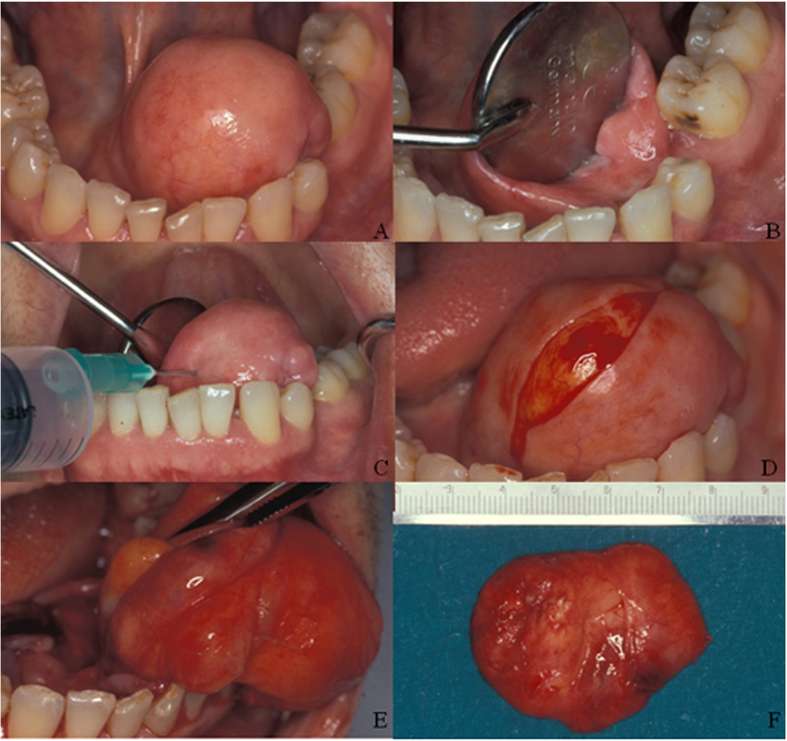
Treatment and Prognosis -
Treated by conservative local excision
Recurrence is rare
Intramuscular type have high recurrence rate( because of their infiltrative growth pattern )

Slide 45
LYPHANGIOMA
Lymphangioma is a benign hamartomatous hyperplasia of lymphatic vessels
Classification of Lymphangioma by Watson and Mc Carty –
Simple lymphangioma
Cavernous lymphangioma
Cellular or hypertropic lymphangioma
Diffuse or systemic lymphangioma
Cystic lymphangioma or hygroma

Slide 46
Aetiology -
Most likely represent a developmental anomaly that arise from a sequestrations of lymphatic tissue that do not communicate with rest of the lymphatic system

Slide 47
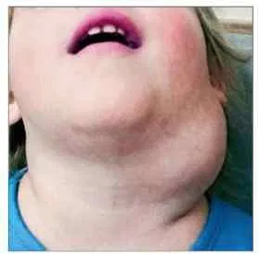
Clinical Features -
Majority of cases – present at birth
Lymphatic malformations have marked predilection for head and neck – this include 50% to 70% of all cases
Cervical lymphatic malformations are more common in posterior triangle – characterised by typically soft , fluctuant masses
They occur less frequently in anterior triangle – lesions in this location can cause dyspnoea or dysphagia as they grow
Occasionally cervical lesions extend upto mediastinum or upward to oral cavity – this type can result in massive enlargement

Slide 48
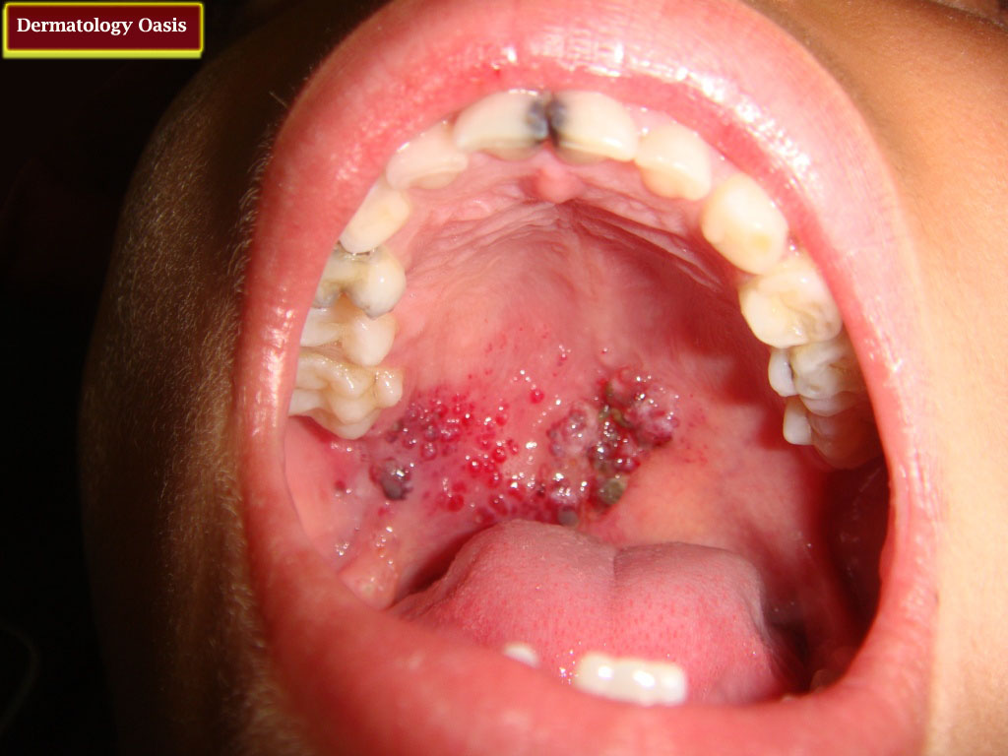
Oral Manifestations -
Intraoral lymphangioma most commonly occurs on tongue
Other common sites – palate , buccal mucosa , gingiva , lips
Superficial lesions – manifestated as papillary lesions which may be of same colour as surrounding mucosa
Deeper lesions – appear as diffuse nodules or masses
In some cases large areas of tissue may be involved
When lip is involved – called macrochelia

Slide 49
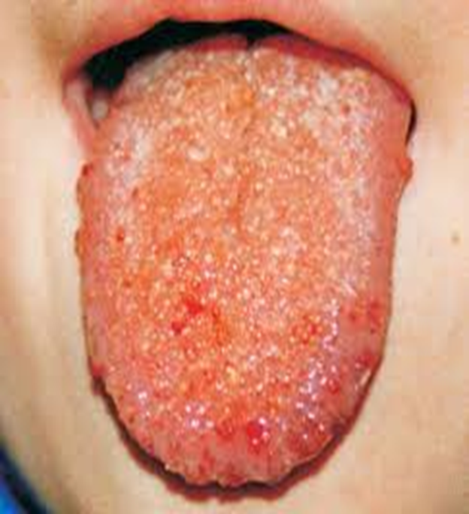
If tongue is affected – macroglossia is seen
Anterior dorsal part of tongue is mostly affected
The irregular nodularity of the surface of tongue with grey and pink projections is commonest sign of disease ( when associated with macroglossia , is pathogmonic of lymphangioma
An unusual form – lymphagioma of alveolar ridge in neonates is sometimes seen

Slide 50
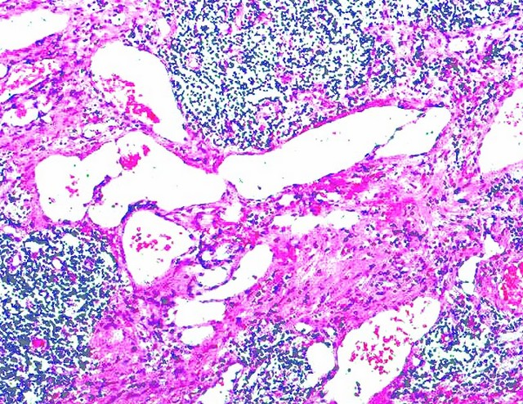
Histological Features -
Consists of multiple interwining lymph vessels in loose fibrovascular stroma
3 types –
Macrocystic – composed of cyst like spaces – 2 cm or greater
Microcystic – composed of smaller vascular channels – less than 2 cm
Mixed – composed of combination of macrocystic and microcystic types

Slide 51
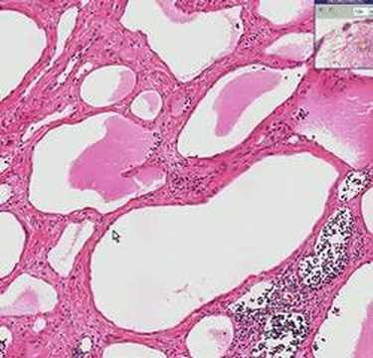
Lymphangioma can be subclassified into –
Lymphangiona simplex ( capillary lymphangioma )
Cavernous lymphangioma
Cystic lymphangioma ( cystic hygroma )
Cavernous lymphangioma is most common , consists of numerous dilated lymphatics , single layer of endothelial cells with flattened , occasionally , plump , nuclei and containing lymph
Occasionally channels may be filled with blood - haemangiolymphangioma

Slide 52
Treatment and Prognosis -
Surgical excision can be the treatment of choice
Spontaneous regression is rare
Because of the non – encapsulated and infiltrating nature , complete removal is often impossible without excessive removal of surrounding normal structures
Surgical debulking of tumour is the typical treatment provided , and additional debulking procedures is most likely required as the child grows

Slide 53
HAEMANGIOMA AND VASCULAR MALFORMATIONS
The term haemangioma traditionally has been used to describe a variety of developmental vascular anomalies
Currently haemangiomas are considered to be benign tumours of infancy that displays a rapid growth phase with endothelial cell proliferation , followed by rapid involution
Vascular malformations are structural anomalies of blood vessels with normal endothelial cell turnover

Slide 54
HAEMANGIOMA | VASCULAR MALFORMATIONS
They are true neoplasms of endothelial cells | They are localised defects of vascular morphogenesis
Arise 1 month after birth | Present since birth
Do not blanch on pressure | Blanch on pressure
Classified as - Capillary haemangioma Cavernous haemangioma Mixed haemangioma | Classified as – Intramuscular venous malformations Capillary malformations Arteriovenous malformations Lymphatic malformations
Females : Males – 3 :1 | Females : Males – 1:1

Slide 55
Clinical Features - Haemangioma
Haemangioms are most common tumors of infancy
Females > males
Most common in head and neck regions
80 % of haemangiomas exist as single lesions
2 types -
SUPERFICIAL TYPE | DEEP TYPE
Appear as raised and bosselated with a bright red colour | Appear slightly raised with a bluish hue
Firm and rubbery on palpation
Blood cannot be evacuated by applying pressure

Slide 56
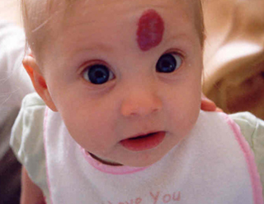
The initial proliferative phase usually lasts for 6 to 12 months , after which tumour grows proportionately with child . By age 5 most of the red colour is gone
Mandible > Maxilla
Haemangiomas are associated with following syndromes –
Rendu – Osler – Weber syndrome
Sturge – Weber – Demitri syndrome
Kasabach –Meritt syndrome
Maffuci syndrome
Von Hippel – Lindau syndrome
Krippal – Trenaunay – Weber syndrome

Slide 57
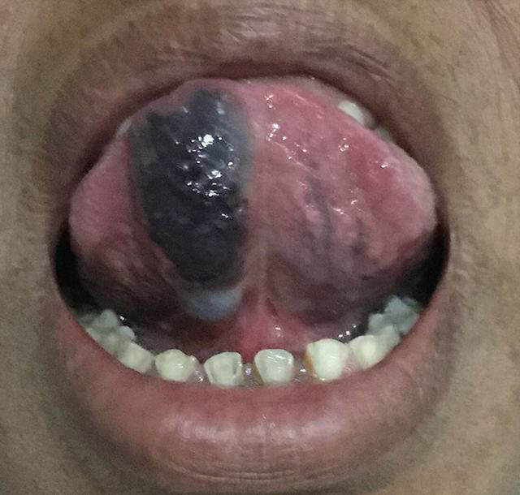
Oral manifestations -
Haemangiomas of oral soft tissue appears as a flat or raised lesion of mucosa , usually deep red or bluish red in colour and seldom well circumscribed
They are readily compressible and fill slowly when released
Most common sites of occurence –
tongue , lips , buccal mucosa and palate

Slide 58
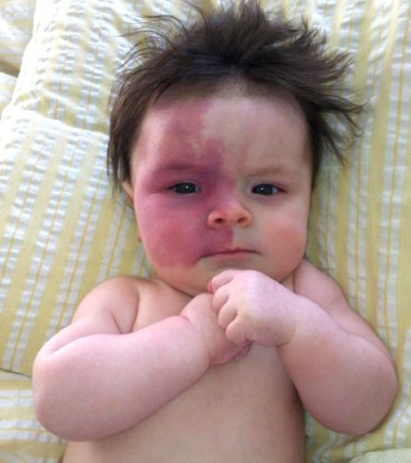
Clinical features – Vascular malformations
They are most common on face
Port wine stains are typically pink or purple macular lesions, as patient grows older , lesion often darkens and become nodular because of vascular ectasia
Arteriovenous malformations are high – flow lesions that result from persistent direct arterial and venous communication
Overlying skin typically feels warmer to touch
Patient present with a symptom of pain , bleeding , skin ulcerations

Slide 59
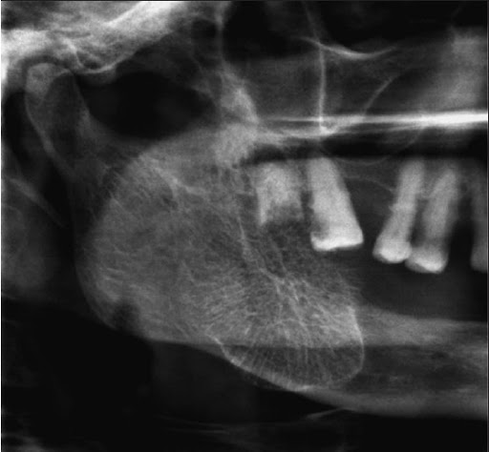
Radiographic features -
The radiographic appearance of intra bony vascular malformations is variable
Most often lesions show a multilocular radiolucent defect
Individual loculations may be small ( Honeycomb appearance) or large ( soap bubble appearance)
Sometimes present as well defined cyst like radiolucency
Large lesions cause cortical expansion – producing Sunburst appearance
INTRAOSSEUS HAEMANGIOMA

Slide 60
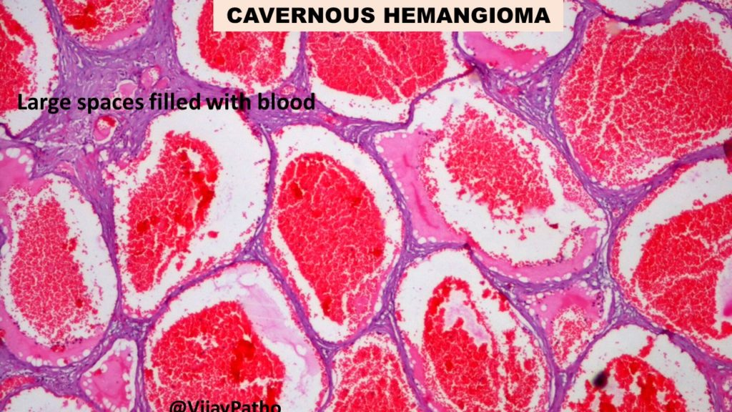
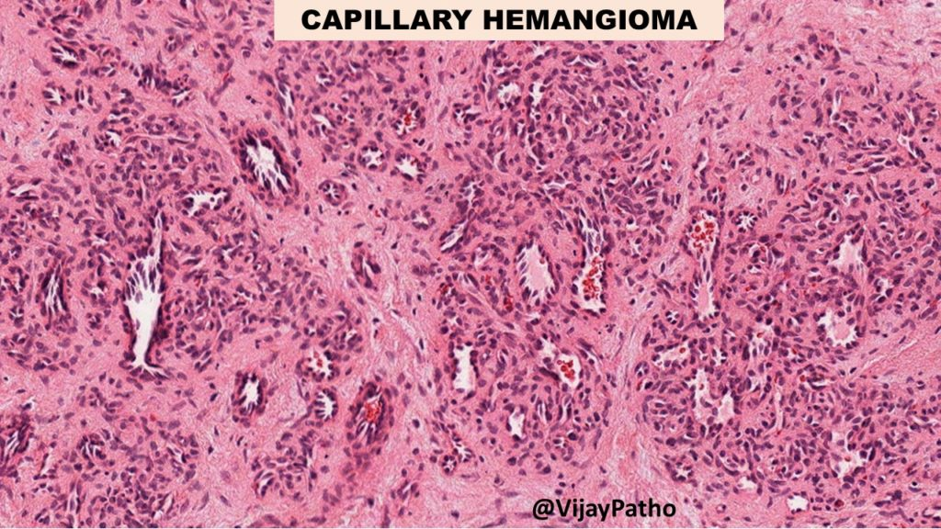
Histological Features -
Haemangiomas comprise of many small capillaries lined by single layer of endothelial cells supported by connective tissue stroma of varying densities
Cavernous haemangioma – consists of large dilated blood sinuses within thin walls
Capillary haemangioma – consists of blood vessels that resemble capillaries

Slide 61
Treatment and Prognosis -
As most of the haemangiomas of infancy undergo involution , management consists of watchful neglect
Cases which do not show remission are treated by –
Surgery
Radiation therapy
Sclerosing agents
Carbondioxide snow
Cryotherapy
Compression

Slide 62
STURGE – WEBER SYNDROME
It is an uncommon condition
Consists of congenital hamartomatous malformations that may affect the eye , the skin and central nervous system at different times , characterised by combination of a venous angioma of leptomeninges over cerebral cortex with ipsilateral angiomatous lesions of face , and sometimes , of skull ,jaws , and oral soft tissues

Slide 63
Aetiology -
The clinical manifestations have a common embryological basis
The primary defect is a developmental insult affecting precursers of tissues that originate in the promesencephalic and mesencephalic neural crest
Affected precursers give rise to vascular and other tissue malformations in the meninges , the eyes and the dermis
To date no gene defect has been associated with this syndrome

Slide 64
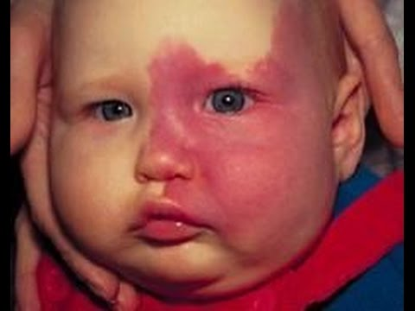
Clinical Features -
It is a congenital syndrome ,that consists of classical triad of clinical manifestations like , facial capillary malformations , intracranial vascular abnormality and glaucoma
At birth port wine nevi (facial cutaneous capillary venous angiomas ) are observed and confined almost exclusively to skin areas supplied by trigeminal nerve .
2nd common feature is presence of typical intracranial convolutional calcifications
Ocular involvement in some
Neurologic manifestations consist of convulsive disorders and spastic hemiplegia

Slide 65
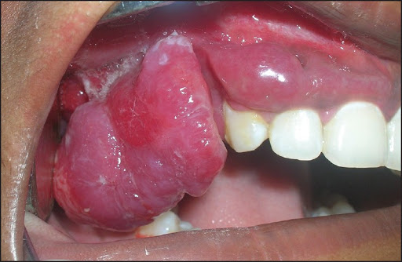
Oral Manifestations -
Occasionally involves the gingiva , buccal mucosa , tongue and lips
These are haemorrhagic areas that can bleed profusely

Slide 66
Treatment and Prognosis -
Convulsions can be controlled by anticonvulsants
Symtomatic and prophylactic therapy for headache
Glaucoma treatment to reduce intraocular pressure
Laser therapy for port -wine stains

