Slide 1
AGE ESTIMATION WITH RADIOGRAPHS

Slide 2
The word forensic states Clark, is derived from the latin word ‘forensis’, which means ‘before the forum’.
On the other hand Odontology refers to the study of teeth or dentistry.

Slide 3
DEFINITION
It is defined as “ the branch of dentistry which, in the interest of justice, deals with the proper handling and examination of dental evidence, and with the proper evaluation and presentation of dental findings.”
This is according to fédération dentaire internationale (FDI).
[Shafers textbook]

Slide 4
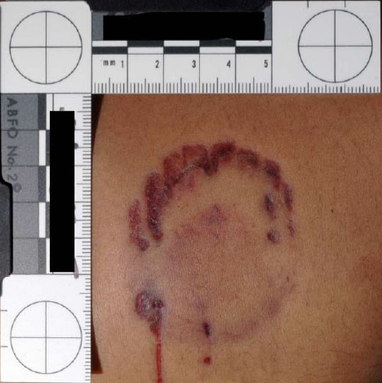
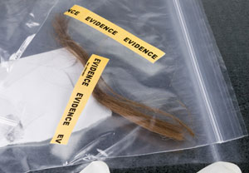
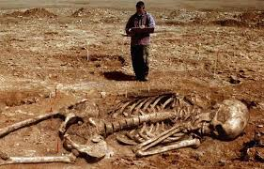
FORENSIC ODONTOLOGIST DELVE INTO
Identifying unknown human remains
Determining the sex of unidentified individuals.
Age estimation of both the living and deceased
Analysis and identification of bite marks found on the victim
Presenting evidence in court as expert witnesses.

Slide 5
Importance of tooth in age estimation
Estimating age from teeth is generally reliable as they are naturally preserved long after all the tissues and even bones have disintegrated.
Evaluation of the dental development has usually played an important part in the process of age determination of children with unknown birth data.

Slide 6
Radiology plays an indispensable role in human age determination.
The application of radiology in forensic science was introduced in the year 1896, just 1 year after the discovery of X-ray by Wilhelm Conrad Roentgen, to demonstrate the presence of lead bullets inside the head of the victim.

Slide 7
Dental findings assessed by radiography are an important source of information in forensic Odontological age determination.
Odontological age estimation can be thought of a triad:
The subject for age estimation
The appropriately chosen developmental survey
The legal considerations.

Slide 8
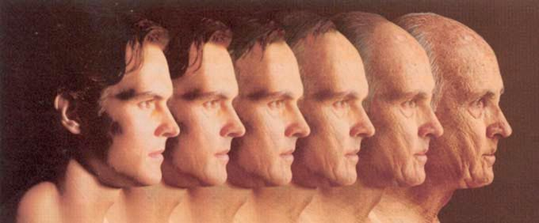
AGE ESTIMATION

Slide 9
Age estimation is grouped into three phases:
Pre natal, natal, post natal.
Children and adolescents and
Adults.

Slide 10
For age determination, two methods are commonly used:
“The atlas method” in which radiographic dental development is compared with published standards and
“ The scoring method’’ in which dental development is divided into various stages that are then assigned the scores that are evaluated through statistical analysis

Slide 11
PRE NATAL, NATAL, POST NATAL
Radiograhically , the mineralization of deciduous central incisors start at the sixteenth week of intrauterine life.
Before the mineralization of tooth germ starts, the tooth germ visible as radiolucent areas on the radiograph.

Slide 12
A radiograph of a mandible taken at the twenty sixth week of intrauterine life shows advanced mineralization in anterior teeth.
The mineralized outline for the two cusps of the deciduous first molar, the one cusp outline for the deciduous second molar and the crypt of permanent first molar are seen.

Slide 13
A radiograph of the mandible of the fetus taken at the thirtieth week of intrauterine life shows 3/5 crown completion for anterior teeth. The deciduous first molar cusp shows fusion. The deciduous second molar with five cusps is seen, while there is no evidence of mineralization of first permanent molar.

Slide 14
The radiograph of a newly born shows completely fused cusps for the deciduous first and second molar, for the deciduous second molar there is no continuity on the occlusal surface. Within the crypt of permanent first molar, there is evidence of tip of mesial cusp.

Slide 15
AGE ESTIMATION IN CHILDREN AND ADOLESCENTS
Dental age estimation in children and adolescents is based on time of emergence of the tooth in the oral cavity and the tooth calcification.
The use of tooth emergence for age estimation should, however, be limited in deciduous teeth.

Slide 16
Their emergence is under genetic control and relatively regular, commencing approximately at six months after birth and completing by about 2½ years.
The radiographic analysis of developing dentition, especially when there is no clinical evidence available as well as the clinical tooth emergence in various phases, will help in age determination.

Slide 17
Method applied for age determination in children and adolescents
Schour and Masselers method.
Moorees, Fanning and hunt method.
Demerjian, Goldstein and tanner method.
Nollas method.
Age estimation using open apices.
Modified Demerjian method.
Indian specific regression method.
Cameriere method.

Slide 18
SCHOUR AND MASSLER’S METHOD
In 1941, Schour and Massler studied the development of deciduous and permanent, describing 21 chronological steps from 4 months to 21 years of age.
The American Dental Association (ADA) has periodically updated these charts in 1932, making it possible to directly compare the calcification stage of teeth on radiograph with standards.

Slide 19
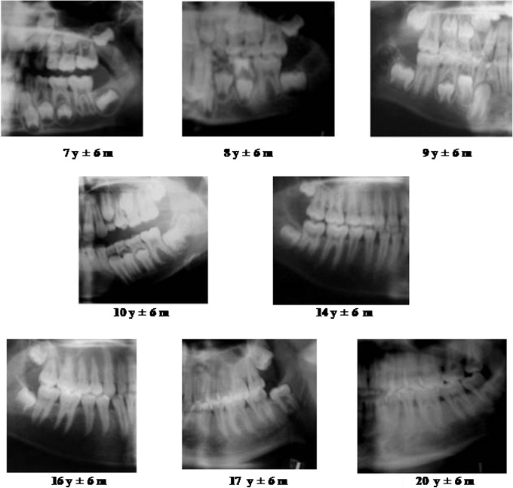

Slide 20
MOOREE’S , FANNING AND HUNT METHOD
In this method the dental development was studied in 14 stages of mineralization for developing single and multirooted permanent teeth and mean age for the corresponding stage is determined.

Slide 22
DEMERJIAN, GOLDSTEIN AND TANNER METHOD:
STAGE DESCRIPTION
A) In both radicular and multiradicular teeth, a beginning of calcification is seen at the superior level of crypt in the form of an inverted cone.

Slide 23
B) Fusion of calcified point forms one or more crypt which united to give a regularly outlined occlusal surface.

Slide 24
C) crown half formed, pulp chamber is evident, dental deposition is occuring.

Slide 25
D)Crown formation is completed down to cemento-enamel-junction, pulp chamber has a trapezoidal form and beginning of root formation is seen

Slide 26
E) Initial formation of the radicular bifurcation is seen, the root length is still less than the crown height

Slide 27
F) The apex ends in funnel shape, the root length is equal to or greater than crown length

Slide 28
G) The walls of root canal are parallel and its apical end is still open.

Slide 29
H) The apical end of root canal is completed closed, the periodontal membrane has a uniform width around the root and the apex.

Slide 32
In Females, the formula is;
Age= (0.0000615× S³ ) - (0.0106× S² )
⁺ ( 0.6997× S ) – 9.3178
In males, the formula is;
Age = ( 0.000055 × S³ ) – ( 0.0095 × S² )
⁺ ( 0.6479 × S ) – 8.4583

Slide 33
NOLLA’S METHOD:
This method has evaluated the mineralization of permanent dentition in ten stages.
The method is used to assess the development of each tooth in maxillary and mandibular arch.
ADVANTAGE :It can be applied to an individual with or without the third molar .Girls and boys are dealt separately.

Slide 36
AGE ESTIMATION WITH OPEN APICES:
Various studies assessed the relationship between the age and measurement of open apices of teeth.
One of the studies were determined in 455 Italian children aged between 5 and 15 years using a panoramic radiograph of the patient.

Slide 37
A :- Root development incompletely, ie; open apices. The distance between open apices is measured.
L:- Tooth length.

Slide 38
These values are substituted in the formula of age estimation:
Age = 8.971 + 0375g + 1.631 × 5 + 0.674 N_{O}
- 1.034 s – 0.176 s.N_{O}.
g = variable equal to 1 in boys
0 = for girls.
the sum of normalized open apices (S)
the number of teeth with root development complete (N₀).

Slide 39
MODIFIED DEMERJIAN METHOD
In 2004 modified their method and developed a new maturity score based on a French population.
The stages of teeth were modified to include two additional stages of non-formation of tooth (Stage “0”) and crypt development (Stage “1”) STAGES 0-9.
Replacement of centile maturity curves with regression formulas incorporation of the third molar.

Slide 40
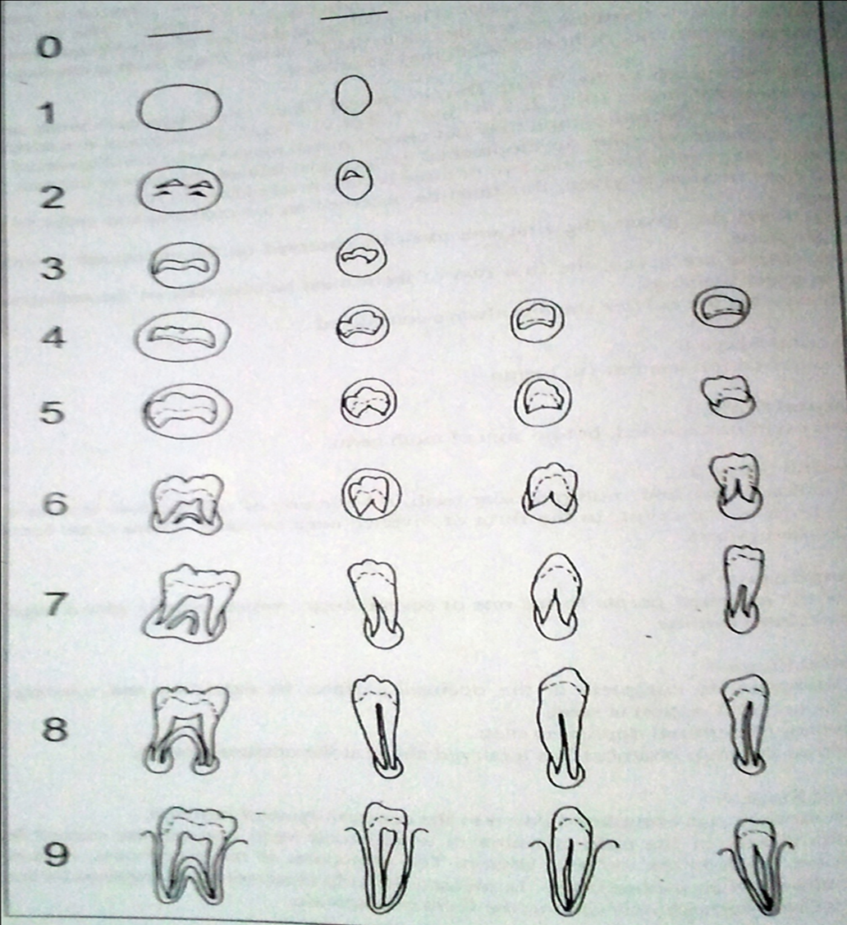

Slide 42
INDIAN SPECIFIC REGRESSION METHOD
As the formulae are based on French population, the showed inferior predilection of age when used in India.
Hence Dr. Ashith B. Acharya in 2011 introduced gender specific, indian specific regression formulae [547 indians (348 females, 199 males)].

Slide 43
The dental age was calculated from dental maturity score using Indian Specific Regression Formula
In Males,
Age = 27.4351 – (0.0097 × S² ) +
(0.000089 × S³ )
In females,
Age = 23.7288 – ( 0.0088 × S² ) +
⁽ 0.000085 × S³ )
Notes:
+

Slide 44
AGE ESTIMATION IN ADULTS
Clinically, the development of permanent dentition competes with the eruption of third molar at the age of 17-21 years, after which the radiographic estimation becomes difficult.
The two methods that are completely followed are
The assessment of volume of teeth.
Pulp-to-pulp ratio method by KVAAL.
Coronal pulp cavity index.
II. The development of third molar
Harris and Nortje method.
Van Heerdan system.

Slide 45
THE ASSESSMENT OF VOLUME OF TEETH
The age estimation in adults can be achieved by radiological determination of reduction in size of pulp cavity resulting from secondary dentine deposition, which is proportional to the age of the individual.

Slide 46
METHOD by kvaal’s et al :
In this method, pulp to tooth ratio were calculated using six mandibular and maxillary teeth.
These values were substituted with a formula
Age = 129.8 – [ 316.4 × M ] [6.8 × (W-L)]
Mean values for all ratios excluding T (M)
Mean value of width ratio B and C (W)
Mean value of length ratio P and R (L)

Slide 47
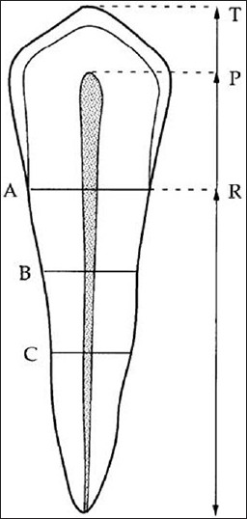
Pulp-root length (R)
Pulp-tooth length (P)
Tooth-root length (T)
Pulp-root width at cej (A)
Pulp-root width at mid root level (C)
Pulp-root width at midpoint between level C and A (B)

Slide 48
The coronal pulp cavity index:
The correlation between the reduction of coronal pulp cavity and chronological age was examined in a sample of 846 intact teeth from 433 of known patient using OPG
In this method the side where the pulp is more visible is chosen so, the mandibular premolars and molars are taken.

Slide 49
In this method length (mm) of tooth crown [CL, coronal length] and the length (mm) of the coronal pulp cavity [ CPCH, coronal pulp cavity height or length].
The tooth-coronal index (TCI) was computed for each tooth
TCI = CPCH × 100
CL

Slide 50
DEVELOPMENT OF THIRD MOLAR
The radiograph age estimation becomes problematic after 17 years of age as eruption of permanent dentition completes by that age with the eruption of the third molar.

Slide 51
HARRIS AND NORTJE METHOD:
CLEFT RAPIDLY ENLARGING-ONE THIRD OF ROOT FORMED
15.8+- 1.4 yrs
5.3+- 2.1 yrs
HALF ROOT FORMED
17.2+- 1.2 yrs
8.6+-1.5 yrs
TWO THIRD ROOT FORMED
17.8+- 1.2 yr
12.9+- 1.2 yr
CONVERGING ROOT CANAL
19.2+- 1.2 yr
16.1+- 2.1 yr
DIVERTING ROOT CANAL
18.5+- 1.1 yr
15.4+- 1.5 yr

Slide 52
VAN HEERDEN system:
The development of the mesial root of third molar is done to determine the age. This system was done using panoramic radiograph.
The males and females were surveyed separately and no significant differences were found between them.

Slide 53
CAMERIERE METHOD
The method is based upon measuring the completeness of apical development via a computer method and all studies to date show a very strong correlation to chronological age.
The aim of the present study was to evaluate the suitability of using Cameriere method standards in a sample of Egyptian children through analysis of panoramic X-ray on teeth.

Slide 54
The number of teeth with complete root development, apical ends of the roots completely closed (N0), was calculated.
the teeth with incomplete root development and therefore with open apices, were considered.
For teeth with one root, the distance (Ai, i=1,...,5) between the inner sides of the open apex was measured.
For teeth with two roots (Ai, i=6, 7), the sum of the distances between the inner sides of the two open apices was calculated.

Slide 56
linear regression formula was used:
Age = 8.971 + 0.375 x g + 1.631 x 5 +
0.674 N0 -1.034 s - 0.176 s x N0
where g is a variable equal to 1 for boys and 0 for girls. Thus the equation points out to advanced dental maturity for girls at all ages.

Slide 58
SKELETAL AGE
The stages of growth can be accurately determined using method base on the skeletal maturation indicators.
Anatomical region suitable for skeletal maturational assessment should have ideally
Region should be small to restrict radiation exposure and expense
Should have many ossification centers which ossify at separate times and which can be standardized.
Region should be easily accessible.

Slide 59
Regions normally used for age assessment
Head and neck : Skull
Cervical Vertebrae
Upper limb : Shoulder joint-scapula
Elbow
Hand wrist and fingers
Lower limb : Femur
Hip joint
Knee
Ankle
Foot-tarsals
Metatarsals
Phalanges

Slide 60
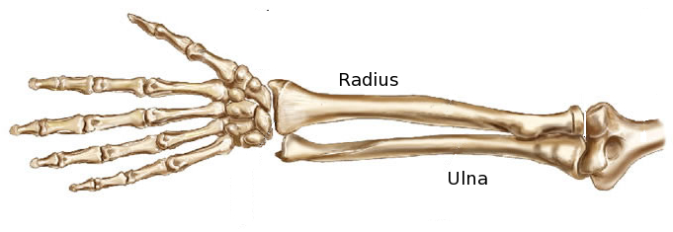
Distal ends of long bones of forearm
the distal ends of radius and ulna, which are long bones of the forearm, were initially used for the purpose of skeletal age determination.
The method is rarely used nowadays and is of more interest for theoretical purpose than for its clinical applicability.

Slide 61
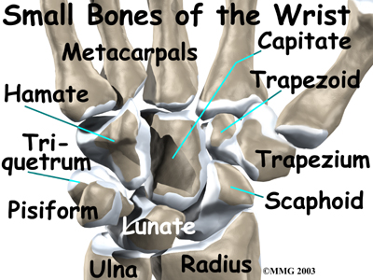
CARPALS
They consists of eight small, irregularly shaped bones arranged in two rows
1.Proximal row : Scaphoid
Lunate
Triquetral
Pisiform
2. Distal row : Trapezium
Trapeziod
Capitate
Hamate

Slide 62
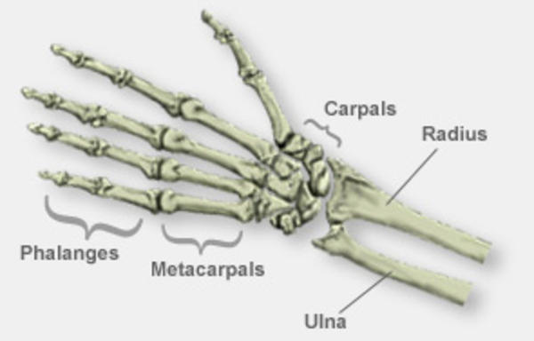
METACARPALS
These are 5 miniature long bones forming the skeletal framework of the palm of the human hand.
They are numbered 1 to 5 from thumb to little finger.
All the metatarsals ossify from one primary ossifying center located in their shafts and a secondary center on their distal end, except the first metacarpal where it appears at the proximal end.

Slide 63
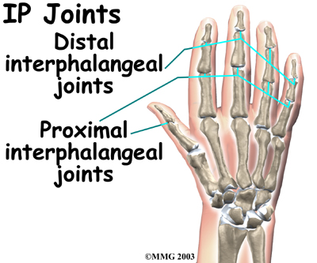
PHALANGES
They are small bones that form the fingers.
There are three phalanges in each finger. The thumb has two phalanges.
The bones of the phalanges are referred as the proximal, middle, distal.

Slide 64
Fishermans method
Keonord S Fishman proposed a system for evaluation for skeletal maturation in 1982.
Fishman made use of four anatomical sites located on the thumb, third finger, fifth finger and radius.

Slide 65
APPEARANCE OF ADDUCTOR SESAMOID OF THE THUMB
EPIPHYSIS IS EQUAL TO THE WIDTH OF DIAPHYSIS
FUSION OF EPIPHYSIS
CAPPING OF EPIPHYSIS

Slide 66
SKELETAL MATURITY INDICATORS
3) Width of epiphysis equal to that of diaphysis in the middle phalanx of fifth finger
5)Capping of epiphysis seen in distal phalanx of third finger
8) Fusion of epiphysis and diaphysis in distal phalanx of third finger
7) Capping of epiphysis seen in middle phalanx of fifth finger
2) Width of epiphysis equal to that of diaphysis in the middle phalanx of third finger
10) Fusion of epiphysis and diaphysis in the middle phalanx of third finger
6) Capping of epiphysis seen in middle phalanx of third finger
9) Fusion of epiphysis and diaphysis in proximal phalanx of third finger
1) Third finger proximal phalanx shows equal width of epiphysis and diaphysis
4) Appearance of adductor sesamoid of the thumb
11) Fusion of epiphysis and diaphysis in the radius

Slide 67
CEREBRAL VERTEBRAE MATURITY INDICATORS
Hassel and Farman developed a system of skeletal maturation determination using cerebral vertebrae.
The shapes of the cerebral vertebrae were found to be different at different levels of skeletal development.

Slide 68
Concavities are developing in lower border
Lower borderof c4 vertebral is flat
C3 and c4 are more rectangular in shape
Distant concavities seen in lower border of c2 and c3
Convavity developing in lower border of c4.
C3 and c4 are rectangular in shape.
Borders of inferior vertebral body is flat
Borders of superior vertebral body is tappered from posterior to anterior
Accentuated concavities of c2, c3, c4 inferior vertebral body border.
C3 and c4 are square in shape.
Deep concavities are present in c2, c3, c4 inferior vertebral body.
C3 and c4 are greater in height than in width.
Distant concavities are seen in lower border of c2, c3, c4.
C3 anf c4 are nearly square in shape.

Slide 69
Karjodkar FR. Role of dental radiology in forensic odontology, Text book of dental and maxillofacial radiology, (2nd edn) pp 929–963.
Shafer's textbook of oral pathology (6th edn) India: Elsevier Private Ltd, 2009, pp 871–892.
Dental radiographic indicators, a key to age estimation AS Panchbhai* Department of Oral Medicine and Radiology, SPD College & Hospital, DMIMSU, Sawangi-M, Wardha, India.2011.
COMPARISON BETWEEN TWO METHODS OF DENTALAGE ESTIMATION AMONG EGYPTIAN CHILDREN BY Amal A. El-Bakary , Shaza M. Hammad * and Fatma M. Ibrahim ** Departments of Forensic Medicine and Clinical Toxicology, Faculty of Medicine, *Orthodontics, **Oral-histology, Faculty of Dentistry, Mansoura University,
Gurkeerat singh text book of orthodonticsDental and Skeletal Age
REFERENCES

Slide 70
THANK YOU

