Slide 1
M R I
Dr Seema A Bhogte

Slide 2
Contents
Introduction
History
Principle
Components
Advantages
Disadvantages
Application

Slide 3
Introduction
Magnetic Resonance Imaging
MRI uses nonionizing radiation from the radiofrequency (RF) band of the electromagnetic spectrum.
Resonance is transfer of vibration energy from one system to another.

Slide 4
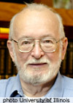
History
Paul C. Lauterbur
Peter Mansfield

Slide 5
Principle

Slide 6
Notes:
Because spin is associated with an electrical charge, a magnetic field is generated in nuclei with unpaired nucleons, causing these nuclei to act as magnets with north and south poles (magnetic dipoles).

Slide 9
The combined effect of these two energy states is a weak net magnetic moment, or magnetization vector (Mv), parallel with the applied magnetic field.

Slide 12
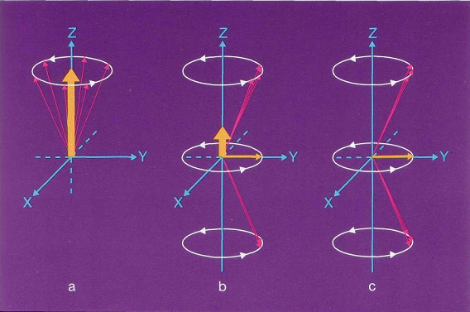
Notes:
In a strong external magnetic field a new magnetic vector along the external field is established in the patient (a). Sending in an RF pulse causes a new transversal magnetization while longitudinal magnetization decreases (b). Depending on the RF pulse, longitudinal magnetization may even totally disappear (c).

Slide 13
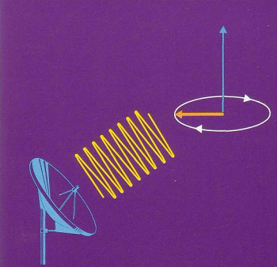
MR Signal
Transverse magnetization vector formed has a precession frequency.
Magnetic vector, by constantly moving, constantly changing, induces an electric current, which is the MRI signal.
Notes:
As the transversal magnetic vector moves around with the precessing protons, it comes towards the antenna, goes away from it, comes towards it again and so on, also with the precession frequency. The resulting MR signal therefore also has the precession frequency.

Slide 14
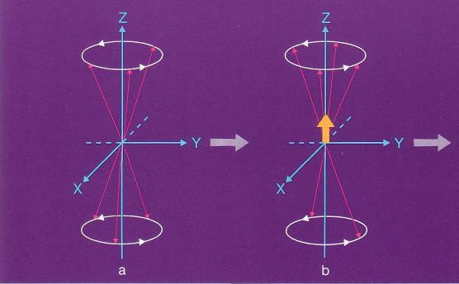
RF pulse is switched off (Relaxation) Longitudinal magnetization increases Decay in transverse vector
Notes:
After the RF pulse is switched off , protons go back from their higher to the lower state of energy, i.e. point up again. This is illustrated "one-by-one". The effect is that longitudinal magnetization increases and grows back to its original value.

Slide 15
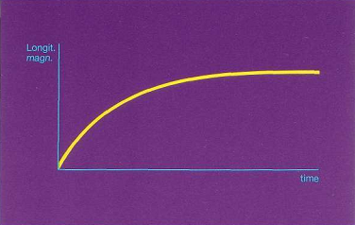
Time vs. longitudinal magnetization
T1 relaxation

Slide 16
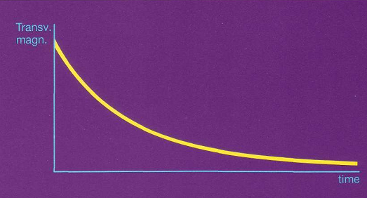
RF pulse is switched off T2 Relaxation

Slide 18
TR & TE
TR (Time to Repeat) is the time interval between start of 1 RF pulse and the start of next RF pulse.
TE (Time to Echo) is the time interval between start of RF pulse and reception of the echo (signal).

Slide 20
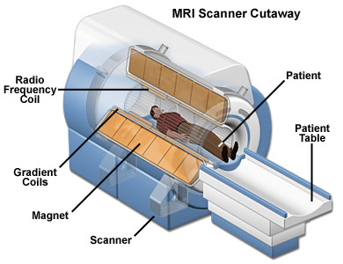
Parts of an MRI machine

Slide 22
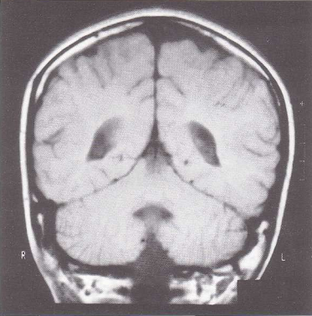
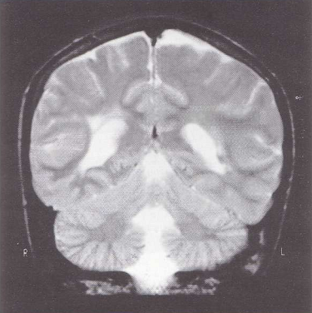
T1 image
T2 image
Fat bright
Fluid dark
Fat dark
Fluid bright

Slide 23
T1 weighted images
T2 weighted images
Anatomical evaluation
Pathological processes

Slide 24
INDICATIONS
Assessment of intracranial lesions
Tumor staging — evaluation of the site, size and extent of all soft tissue tumors including nodal involvement
— The salivary glands
— The tongue and floor of mouth
— The pharynx
— The larynx
— The sinuses
— The orbits
Investigation of the TMJ
When diagnosis of internal derangement is in doubt
As a preoperative assessment before disc surgery

Slide 25
CONTRAINDICATIONS
Patients with electrically, magnetically and mechanically activated implants
cardiac pacemakers,
neurotransmitters,
electronic cochlear implants
Aneurysmal clips in the central nervous system.
Notes:
As the strong magnetic field may move them and fatal results.

Slide 26
Dental considerations
Metals used in restorations or orthodontics will not move but may distort the images.
Removable appliances should be removed
Titanium implants cause only minor image degradation
Notes:
Gold and stainless steel are ferromagnetic materials

Slide 27
ADVANTAGES
Ionizing radiation is not used
No adverse effects have yet been demonstrated
Non- invasive
high quality soft tissue resolution

Slide 28
ADVANTAGES
Excellent differentiation between different soft tissues is possible and between normal and abnormal tissues
enabling useful differentiation between benign and malignant disease
between recurrence and postoperative effects
Useful in determining intra-medullary spread.

Slide 29
DISADVANTAGES
Long imaging time
Limited availability
Limited information about hard tissue
Various metals in the imaging field
either distort the image or
move into strong magnetic field injuring the patient
Claustrophobia
Notes:
No teratogenic effects have been reported but possible mechanisms for embryologic damage have been proposed. Hence women in their 1st trimester should be excluded because of sound & heat.

Slide 30
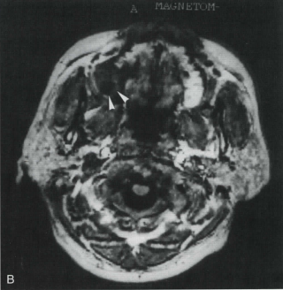
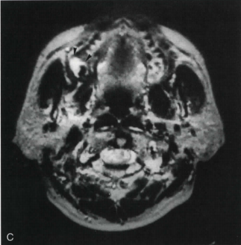
Dentigerous cyst
On MR imaging, the contents of the cyst show high signal intensity on T2 weighted images and low to intermediate intensity on T1 weighted images.

Slide 31
Ranula
T1 weighted image
T2 weighted image

